Slide 1
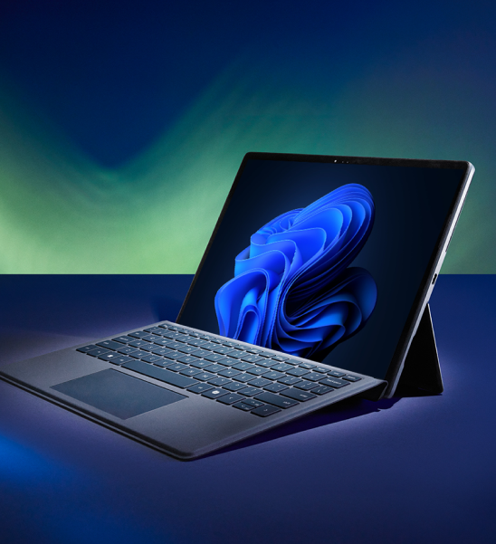
Set the pace with faster performance
Make a bigger impact today with accelerated performance, all day battery life¹ and optional NPU for new AI experiences.
42%
faster completion of demanding workloads on average³
Start upgrading to Windows 11 Pro PCs today
Don’t wait to benefit from the latest advances in business-ready AI, including Copilot+ PCs.
Estimate financial benefits with the Forrester Windows 11 Devices Calculator
Learn how you can check if your PCs meet Windows 11 system requirements
Create a deployment roadmap and prepare for Windows 11
App assure program to help you resolve issues free of charge
Prepare your pilot deployment
Stay up-to-date and protected against evolving threats
Shield your business now with the latest security updates and layers of powerful hardware-backed protection enabled by default.
58%
reported drop in security incidents⁴
More resources
IDC Executive Brief: The Refresh Imperative: The Value of Deploying New, More Secure, Generative AI Centric PCs Ahead of the Windows 10 End of Service
Forrester Study: Total Economic Impact™ of Windows 11 Pro Devices
Windows 11 Pro for business
Plan for Windows 10 EOS with Windows 11, Windows 365, and ESU
See how other customers experienced a smooth upgrade from Windows 10 to Windows 11 Pro
Make the move to supercharged efficiency now
You can't save time with outdated devices. New Windows 11 Pro PCs can enhance every workstyle with business AI and features to get organized in a snap.
50%
Faster workflows on average³
Outdated PCs put your business at risk
Upgrade before support ends for Windows 10 on October 14, 2025. When support ends, you’ll no longer receive Windows feature and security updates, which could potentially put you at risk.
Why wait to innovate? New Windows 11 PCs can deliver a reported 250% ROI² with benefits like reduced help desk calls, improved productivity and security, and easier deployment.
Easy to deploy, compatible with existing tech
Designed to work with your existing technology, Windows 11 Pro enables rapid deployment, automated updates, and granular control across apps, data, and AI.
80%
reduced number of helpdesk tickets²
¹Battery life varies based on settings, usage, device and other factors.
²Commissioned study delivered by Forrester Consulting “The Total Economic Impact™ of Windows 11 Pro Devices”, December 2022. Note, quantified benefits reflect results over three years combined into a single composite organization that generates $1 billion in annual revenue, has 2,000 employees, refreshes hardware on a four-year cycle, and migrates the entirety of its workforce to Windows 11 devices.
³Compared to Windows 10 devices. Improve your day-to-day experience with Windows 11 Pro laptops, Principled Technologies, February 2023.
⁴Windows 11 Survey Report. Techaisle, February 2022. Windows 11 results are in comparison with Windows 10 devices.

Slide 2
Partner Logo
Set the pace with faster performance
Make a bigger impact today with accelerated performance, all day battery life¹ and optional NPU for new AI experiences.
42%
faster completion of demanding workloads on average³
Start upgrading to Windows 11 Pro PCs today
Don’t wait to benefit from the latest advances in business-ready AI, including Copilot+ PCs.
Estimate financial benefits with the Forrester Windows 11 Devices Calculator
Check to see if your PCs meet Windows 11 system requirements
Create a deployment roadmap and prepare for Windows 11
App assure program to help you resolve issues free of charge
Prepare your pilot deployment
Stay up-to-date and protected against evolving threats
Shield your business now with the latest security updates and layers of powerful hardware-backed protection enabled by default.
58%
reported drop in security incidents⁴
More resources
IDC Executive Brief: The Refresh Imperative: The Value of Deploying New, More Secure, Generative AI Centric PCs Ahead of the Windows 10 End of Service
Forrester Study: Total Economic Impact™ of Windows 11 Pro Devices
Windows 11 Pro for business
Plan for Windows 10 EOS with Windows 11, Windows 365, and ESU
See how other customers experienced a smooth upgrade from Windows 10 to Windows 11 Pro
Make the move to supercharged efficiency now
You can't save time with outdated devices. New Windows 11 Pro PCs can enhance every workstyle with business AI and features to get organized in a snap.
50%
Faster workflows on average³
Outdated PCs put your business at risk
Upgrade before support ends for Windows 10 on October 14, 2025. When support ends, you’ll no longer receive Windows feature and security updates, which could potentially put you at risk.
Why wait to innovate? New Windows 11 PCs can deliver a reported 250% ROI² with benefits like reduced help desk calls, improved productivity and security, and easier deployment.
[Partner CTA]
[Partner CTA goes here]
Easy to deploy, compatible with existing tech
Designed to work with your existing technology, Windows 11 Pro enables rapid deployment, automated updates, and granular control across apps, data, and AI.
80%
reduced number of helpdesk tickets²
¹Battery life varies based on settings, usage, device and other factors.
²Commissioned study delivered by Forrester Consulting “The Total Economic Impact™ of Windows 11 Pro Devices”, December 2022. Note, quantified benefits reflect results over three years combined into a single composite organization that generates $1 billion in annual revenue, has 2,000 employees, refreshes hardware on a four-year cycle, and migrates the entirety of its workforce to Windows 11 devices.
³Compared to Windows 10 devices. Improve your day-to-day experience with Windows 11 Pro laptops, Principled Technologies, February 2023.
⁴Windows 11 Survey Report. Techaisle, February 2022. Windows 11 results are in comparison with Windows 10 devices.

Slide 3
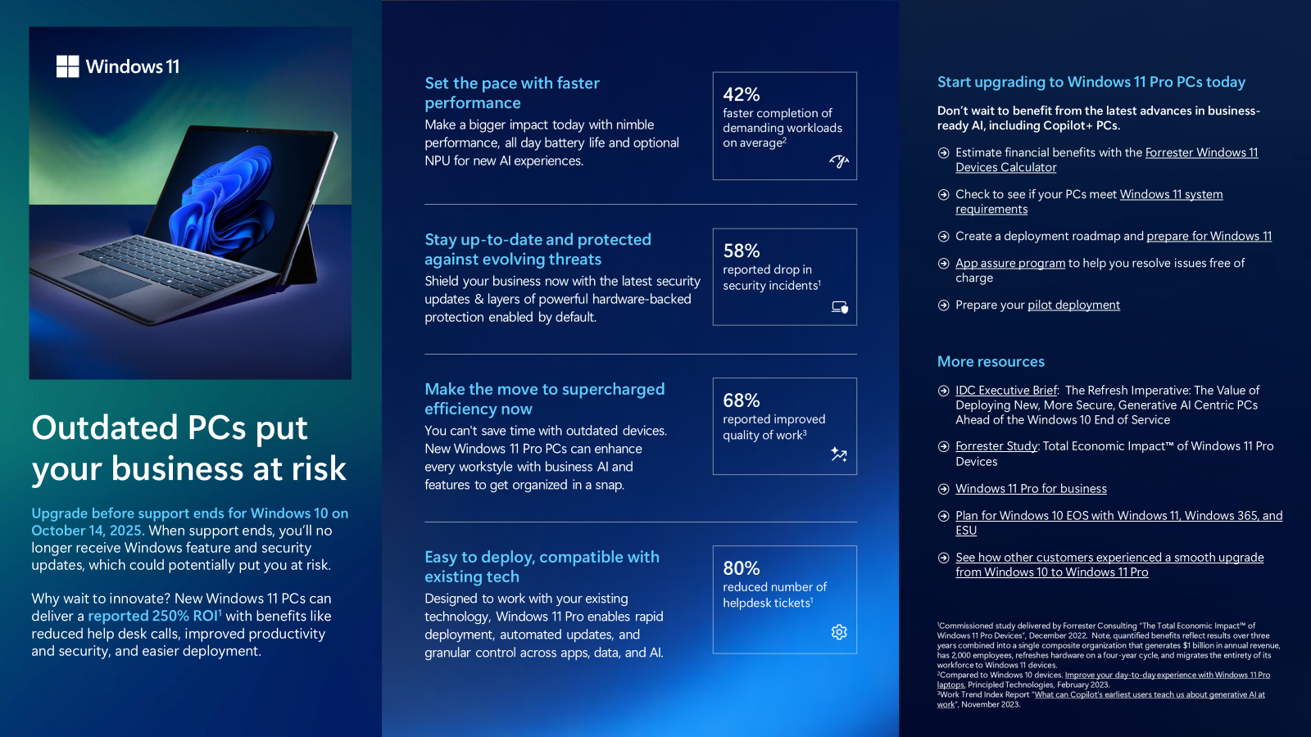
Conversation-starters
What is your plan to migrate to Windows 11 ahead of Windows 10 EOS?
Have you assessed which devices are ineligible for upgrade?
How are you managing identities, deployment, and security policies?
What apps are you using, and where are employees located?
Customer objection handling
Our Windows 10 PCs work fine.
New Windows 11 Pro devices are designed for the latest AI-enhanced features to help improve insights and efficiency. Older devices may be costing more than you realize in management time, security risk, and lower productivity. Outdated technology also dampens employee satisfaction.
I love my Windows 10 PC.
With Windows 11, you can save time and effort. New PCs start faster, simplify workflows, run apps better and faster, and support innovations like Copilot. Plus, new devices have longer battery life and come in a variety of sleek, versatile form factors making it easy to work anywhere.
I am planning to move to Windows 11.
What is your upgrade roadmap? It’s essential to identify which PCs are ineligible for upgrade. Upgrading eligible existing devises is as easy as a feature update. For easy assessment use Endpoint analytics with Microsoft Intune or Configuration Manager. You can use this resource to plan your upgrade to Windows 11.
Windows 10 won’t work with my apps.
Most Windows 10 applications are compatible with Windows 11—and the App Assure program is available to resolve issues at no charge. Windows also supports the broadest app, peripheral, and device ecosystem, so you can choose the setup that’s right for your business.
I have lots of time until the EOS deadline.
We highly recommend you start now. A well-structured and phased approach ensures a smoother transition, minimizes disruptions, and maximizes the benefits of upgrading to Windows 11. Plus, why wait to get a competitive edge with AI-enhanced productivity, or delay protecting your business with the most secure Windows ever?
Partner ready companion to flyer
Windows 10 EOS, FY25Q2
Windows 11 Pro value prop
Windows 11 Pro PCs built for game-changing AI, faster performance, and the most powerful Windows security by default. You can solve problems faster and speed workflows with intelligent business-ready devices.
Key statistics for modern Windows 11 Pro devices
Multiple studies of Windows 11 Pro on new devices reveal that commercial organizations are experiencing true business value and tangible benefits, including:
42% faster completion of demanding workloads on average
50% faster workflows on average
58% reported drop in security incidents
80% reported reduction of helpdesk tickets
The opportunity
Most SMBs aren’t aware of the latest security and productivity benefits, or how easy Windows 11 Pro is to deploy and manage—including compatibility with mission-critical applications.
And with new Windows 11 Pro PCs as the cornerstone of their IT environment, you can help them create a roadmap for leveraging new AI and cloud capabilities with Copilot and Microsoft 365.
New Windows 11 Pro PC advantages
Saves time with AI-enhanced workflows
Optimized for Microsoft 365
Optional on board NPU for supercharged performance
High quality cameras, microphone, and displays
Enhanced pen, ink, touch, and voice support
61% longer battery life on average with more responsive performance
Additional Resources
Windows 11 Pro for business
Windows Insider Program
Quick Start Guides
Existing Windows users switching to Windows 11 Pro
Apple users switching to Windows 11 Pro

